Slide 1

LMECA2300 – Advanced numerical methods
Seminar One – Neighbouring particles
Arno Van de Vyver
Antoine Gilliard
Enrico Marazzi

Slide 2
Neighbourhood in Lagrangian model
Lagrangian by opposition to Eulerian modelling follows individual particles through time
In very large and dense domains, it becomes very costly to measure effects all particles have on each other
Having a neighbourhood allows us to significantly reduce computation costs
Effect from particles past a certain radius can be deemed negligible

Slide 3
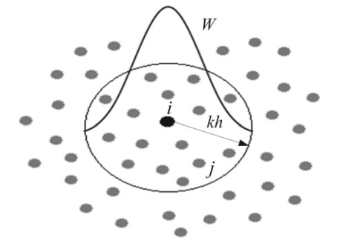
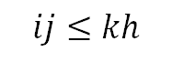
Definition of the neighbourhood
Choice of the radius in order to have enough neighbouring particles
1D | 5
2D | 21
3D | 57
$$ij≤kh$$
particle j in neighbourhood of i

Slide 4
First algorithm: Direct Search
Consider the reference particle (i)
Compute the distance of every particle (j) with respect to the reference one
If the distance (ij) is smaller or equal than kh
Particle j is in the neighbourhood of particle i

Slide 5
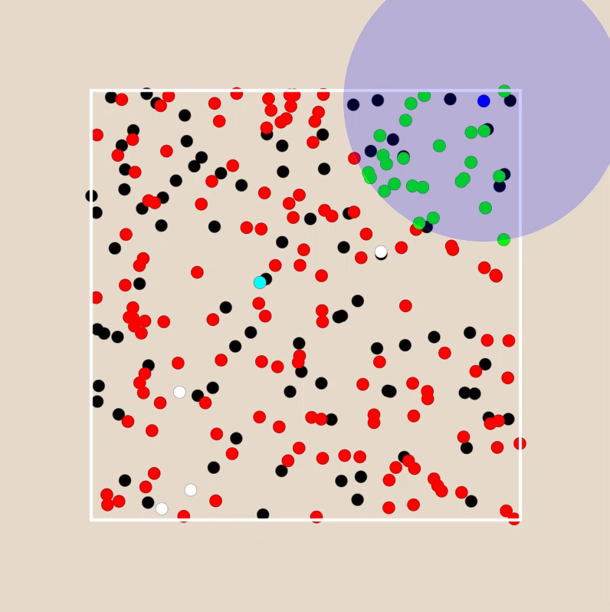

Slide 6
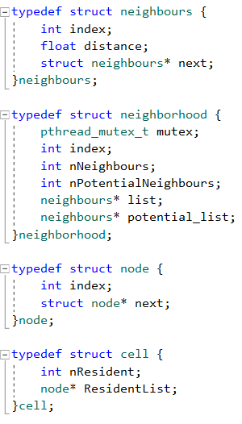
Data structure for the basic search

Slide 7
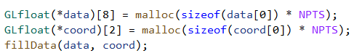
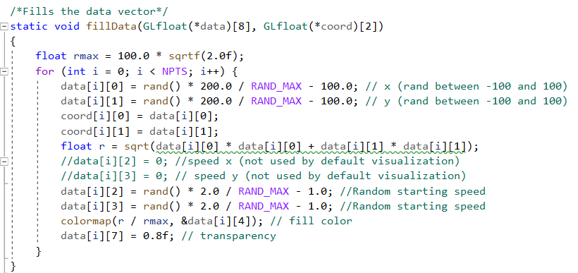

Slide 8
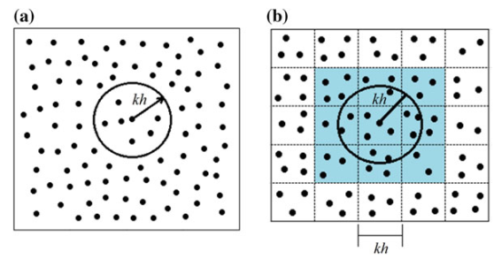
Second algorithm: Cell Search
Use of a grid:
Only particles in cells adjacent to the one of the reference particle will be analysed
Physical space into domains

Slide 9
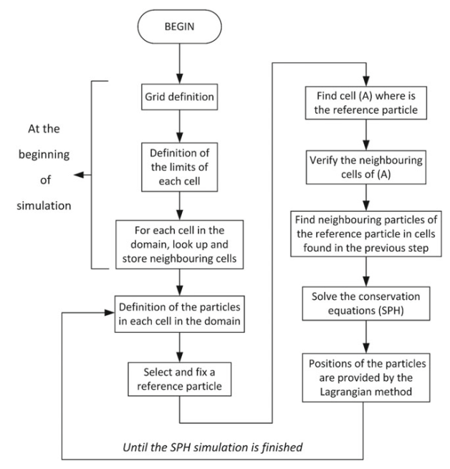

Slide 10
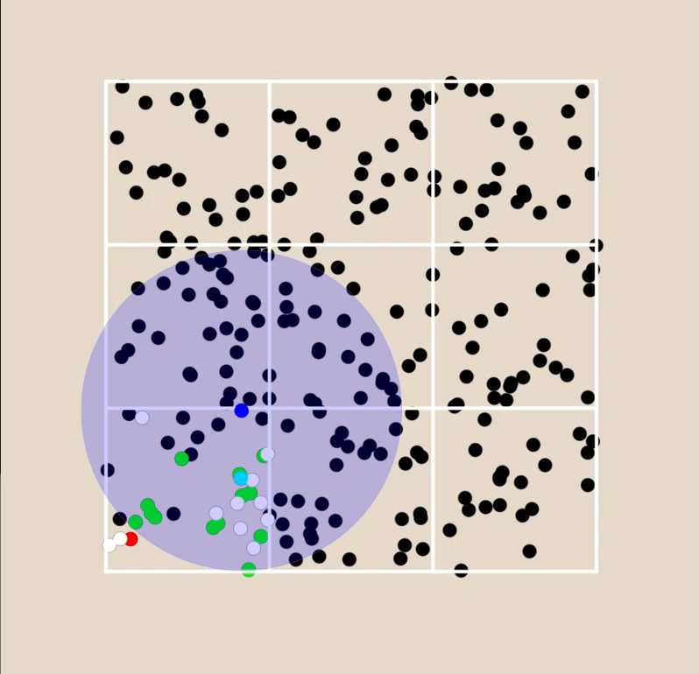

Slide 11
Data structure for the cell search

Slide 12
Pair update
When a neighbour is found it is inserted in the neighbouring list of the reference particles
The reference particles is added to the neighbouring list of the neighbour part as well

Slide 13
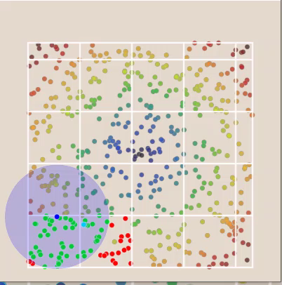
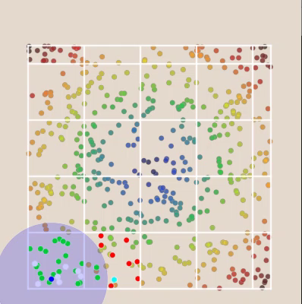
Basic method
Improved method

